Slide 1
Capstone QA Automation Project
Name – Om Prakash Sahu
Proficient in Java, Selenium WebDriver, TestNG, and Cucumber BDD for building maintainable automation frameworks. Experienced in Jira/Zephyr test management, Git version control, and CI/CD pipelines for efficient, traceable releases

Slide 2
Web Application - demo.nopcommerce.com
• Type: E‑commerce web application (demo version of nopCommerce platform).
• Purpose: Showcases online shopping features like product browsing, filtering, cart, checkout, payment, and order management.
Key Objectives :
Automate functional testing using Selenium WebDriver and TestNG.
Integrate automation into a CI/CD pipeline with Jenkins for automatic execution on code commits.
Use Git/GitHub for version control and collaborative development.
Manage requirements, test cases, and defects in Jira/Zephyr.
Implement Cucumber BDD for readable, stakeholder‑friendly test scenarios.
Generate ExtentReports with screenshots for detailed execution reporting.

Slide 3
Type of Testing
• Manual Testing – Executing test cases without automation to validate functionality, usability, and UI.
• Automation Testing – Using Selenium WebDriver with Java to automate repetitive and regression test cases.
• CI/CD‑Integrated Testing – Automated test execution triggered via Jenkins pipelines on every code commit or scheduled build.
Tools & Technologies Used -
• Git – Distributed version control for tracking changes and collaborating on code.
• GitHub – Remote repository hosting for code sharing and integration with CI/CD.
• Maven – Build automation and dependency management for Java projects.
• Jenkins – Continuous Integration/Continuous Deployment tool to schedule and run automated tests.
• Selenium WebDriver – Browser automation for functional and regression testing.
• TestNG – Test framework for grouping, prioritizing, and parallel execution.
• Cucumber (BDD) – Behavior‑Driven Development for readable, stakeholder‑friendly test scenarios.
• Jira + Zephyr – Test management, traceability, and defect tracking.
• ExtentReports – Custom HTML reports with screenshots for execution results.

Slide 4
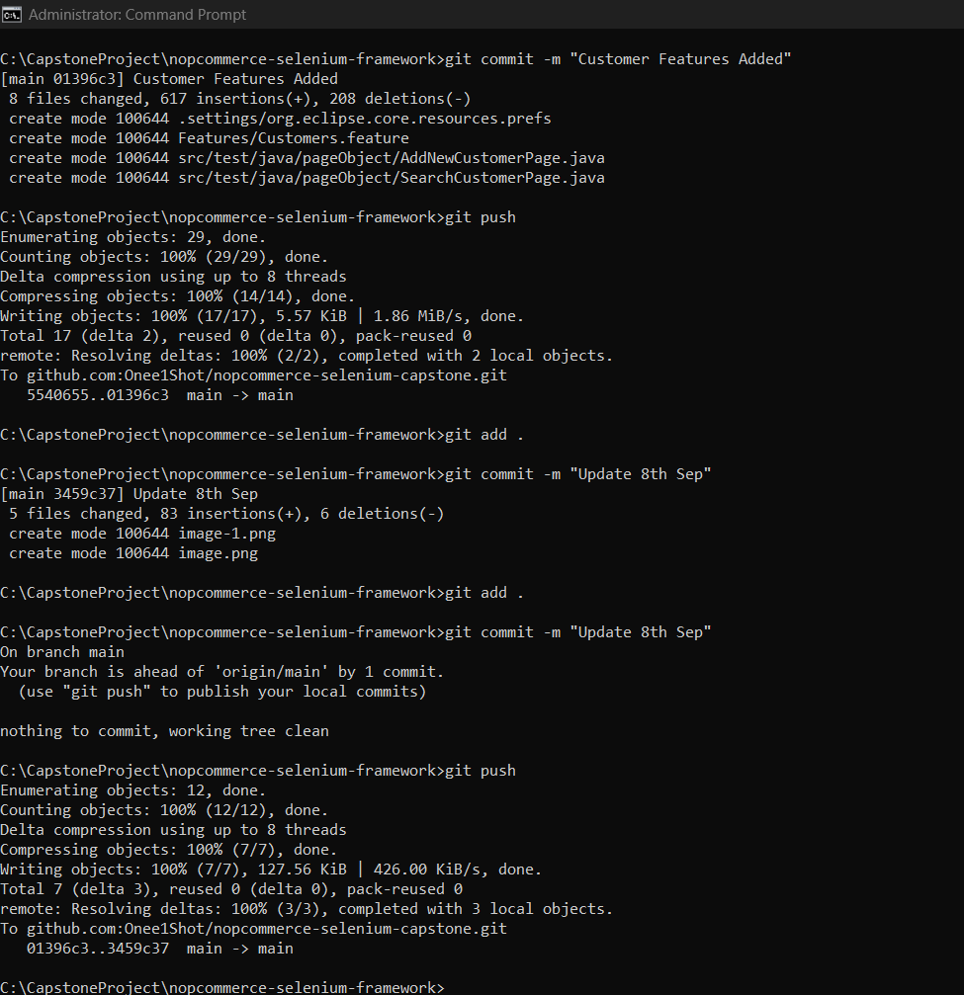
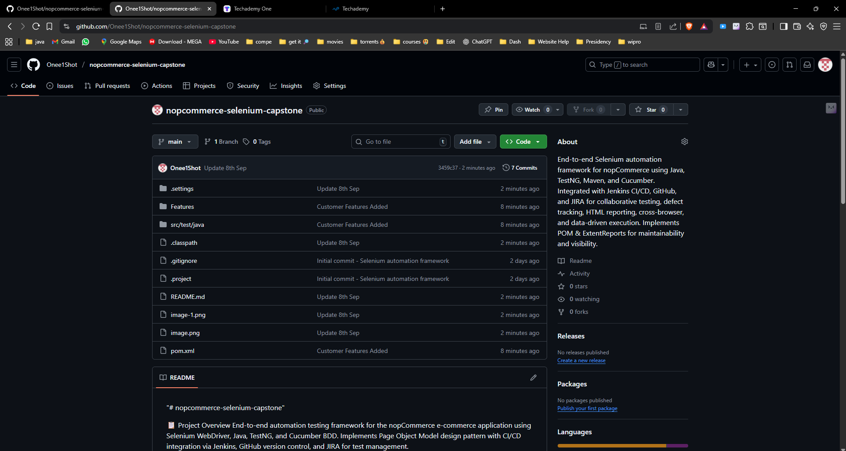
Automation framework Screenshot from Github repository

Slide 5
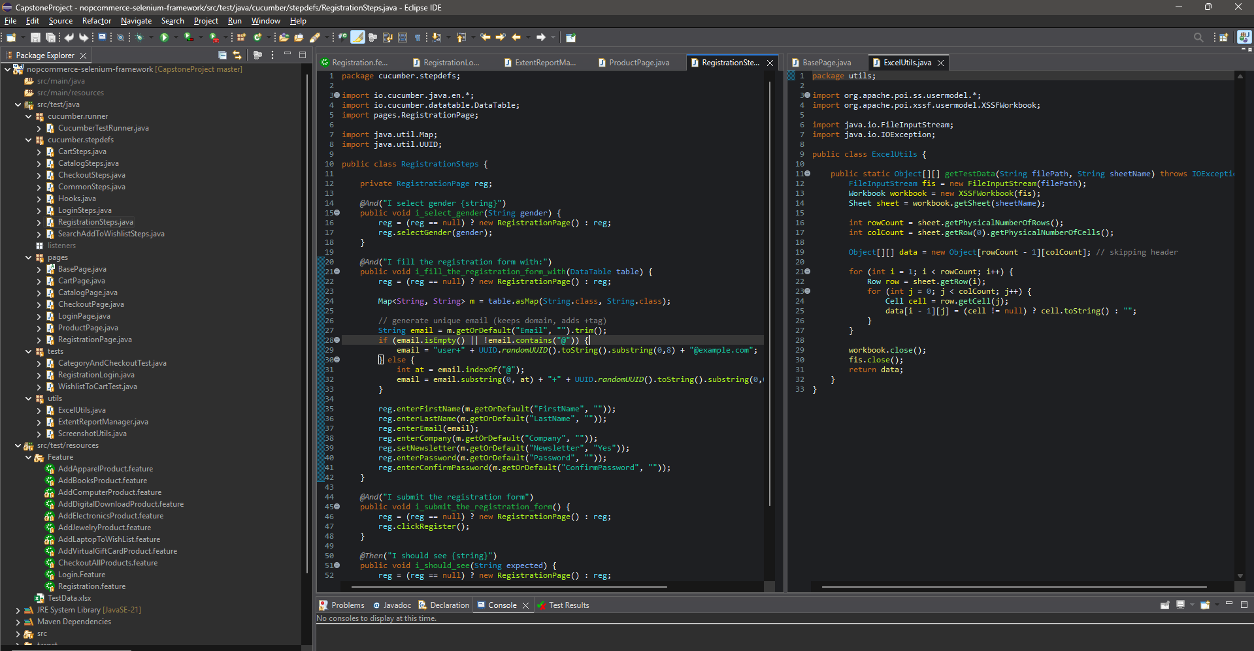
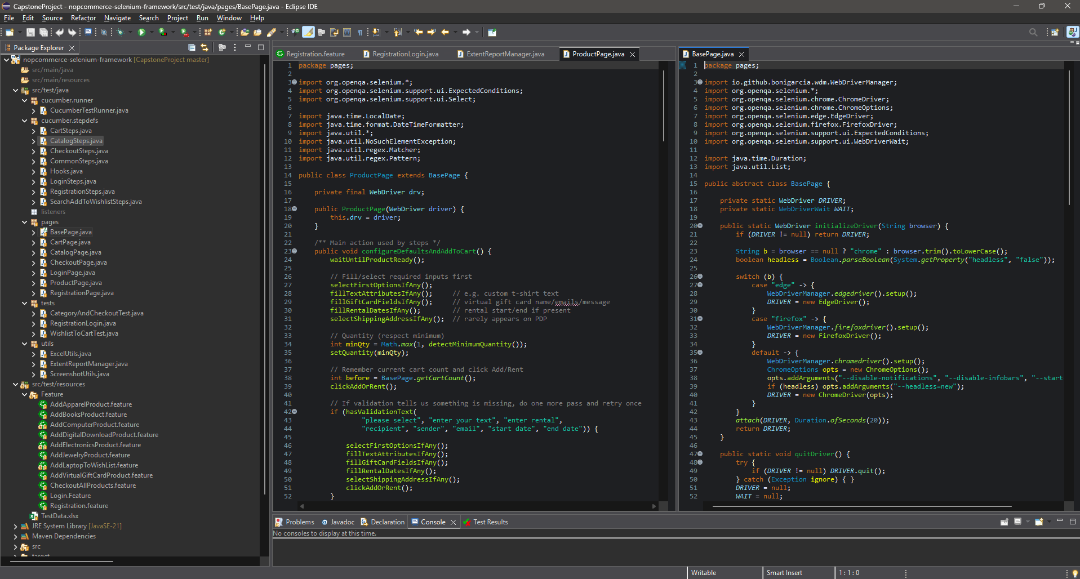
Automation approach,page object model and Data Driven testing

Slide 6
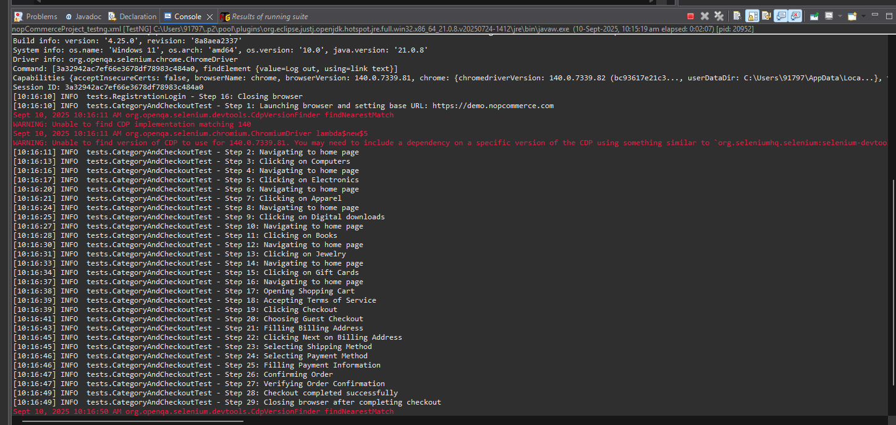
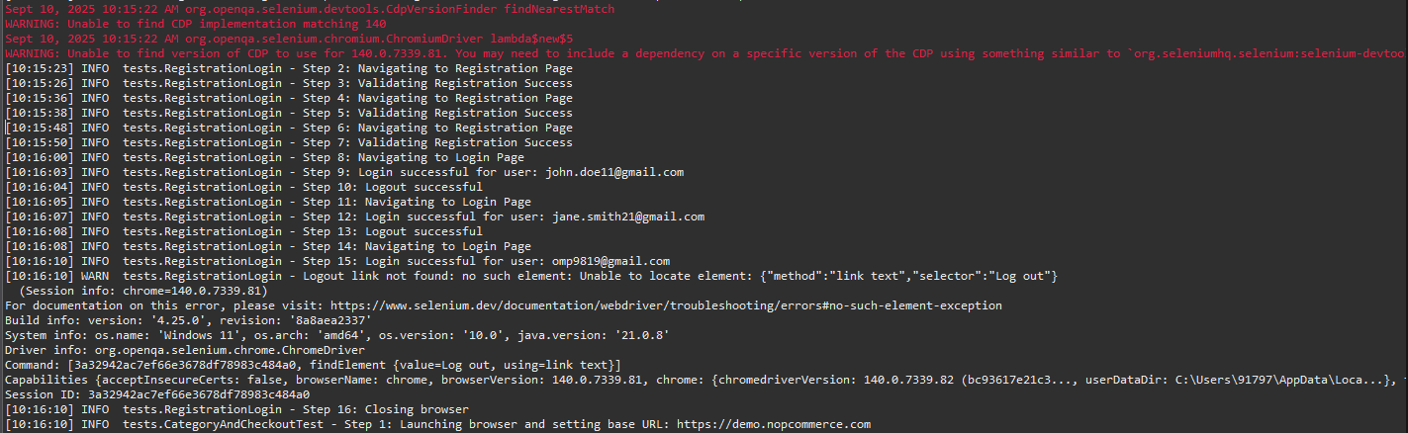
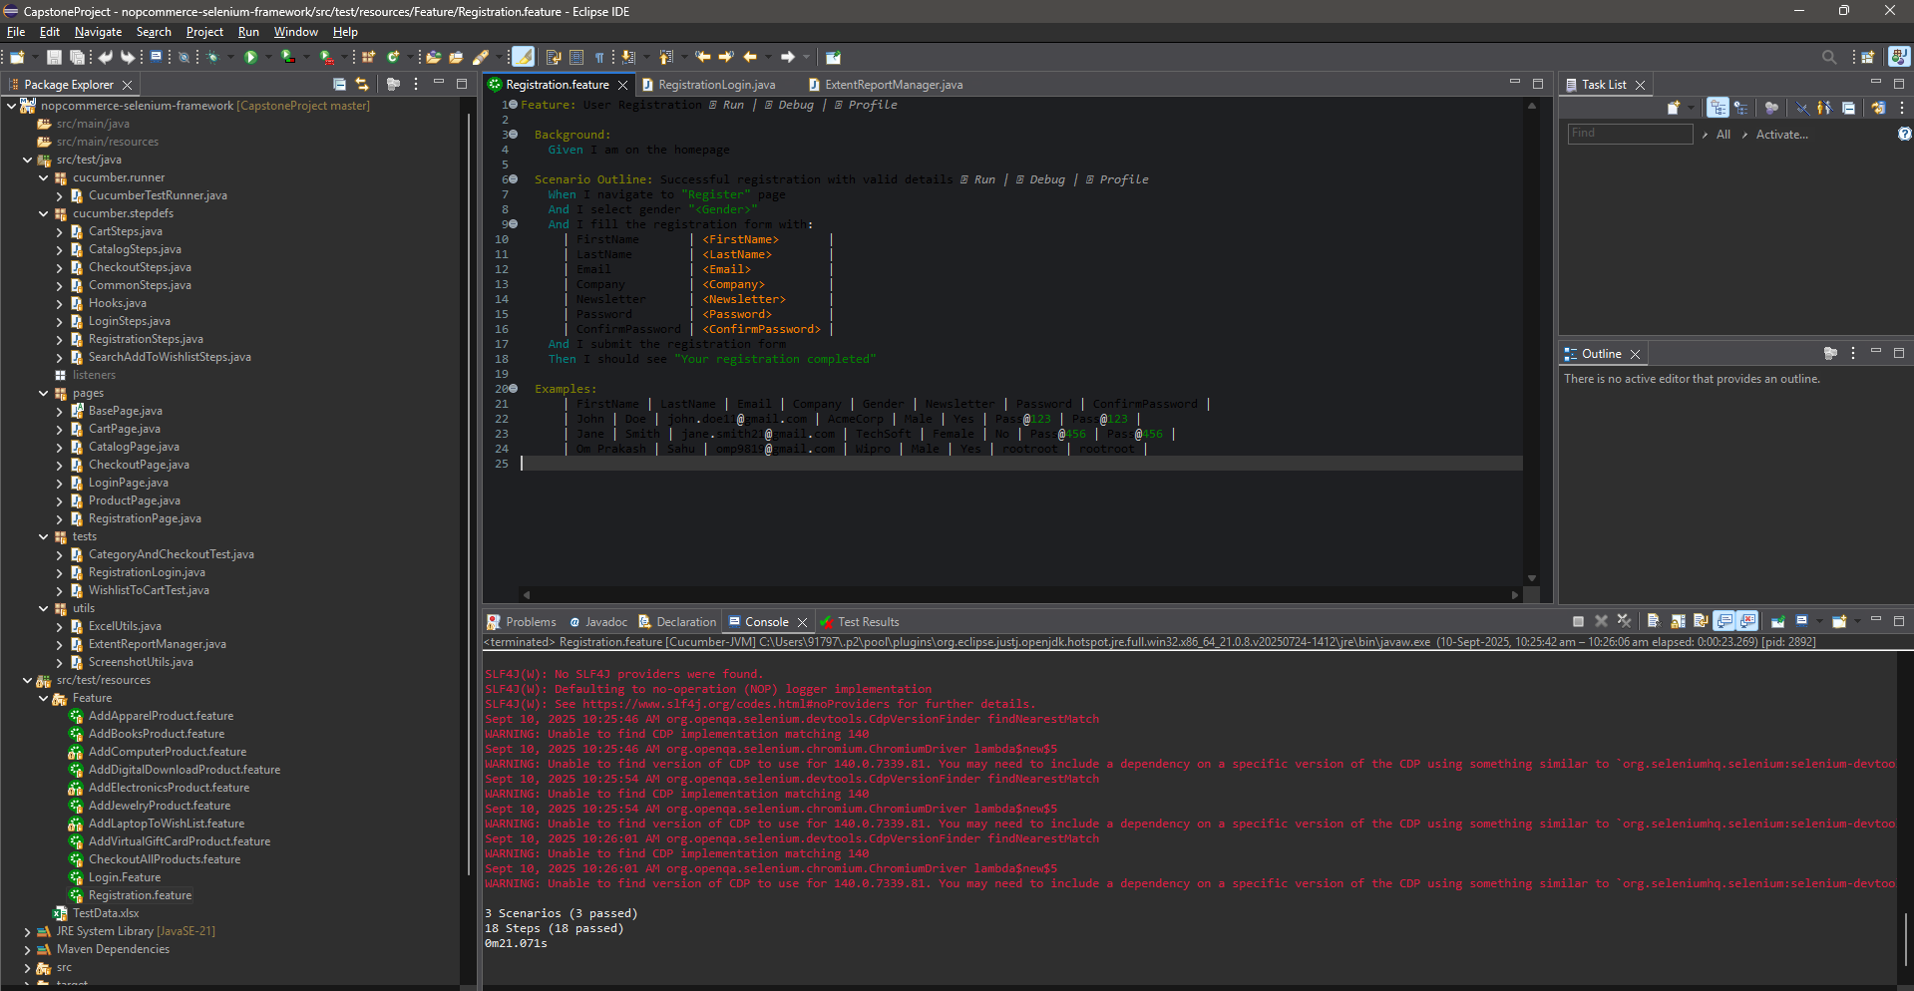
Test Cases Passed TestNg

Slide 7
Description of My work
Designed and implemented a robust Selenium WebDriver + Java automation framework using TestNG and Cucumber BDD for the nopCommerce demo web application.
Applied Page Object Model (POM) design pattern with reusable utilities for WebDriver setup, waits, logging, reporting, and data‑driven testing via Apache POI.
Managed requirements, user stories, and test cases in Jira, with full traceability and execution tracking in Zephyr.
Integrated Git/GitHub for version control and collaborative development, ensuring clean branching and commit workflows.
Configured Jenkins CI/CD pipelines to automatically pull code, execute TestNG/Cucumber suites, and publish ExtentReports with screenshots after each build.
Performed cross‑browser testing on Chrome and Firefox to validate compatibility and stability.
Delivered detailed execution reports, defect logs, and final project documentation for end‑to‑end QA coverage.

Slide 8
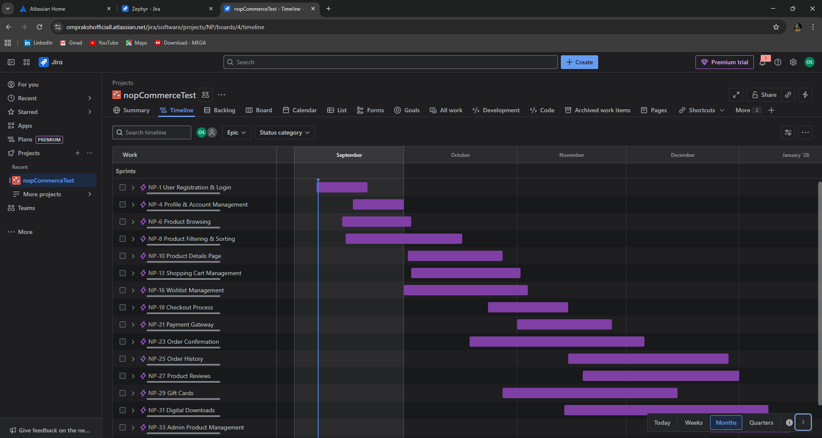
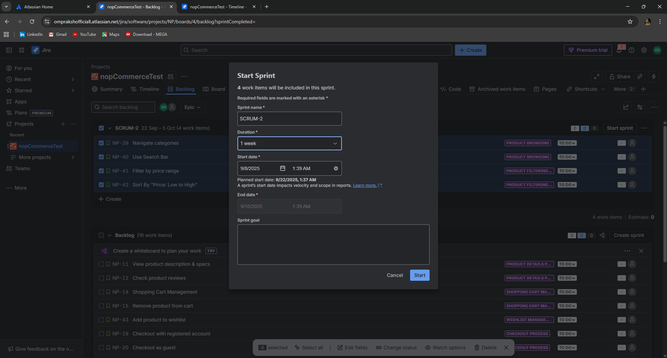
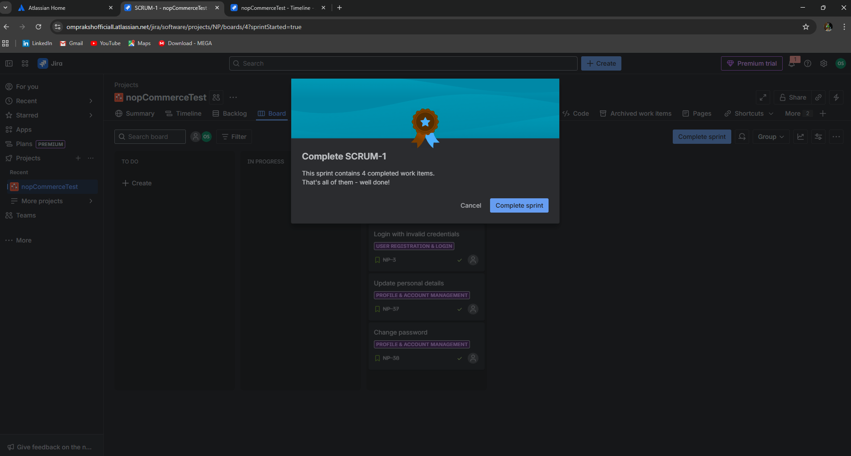
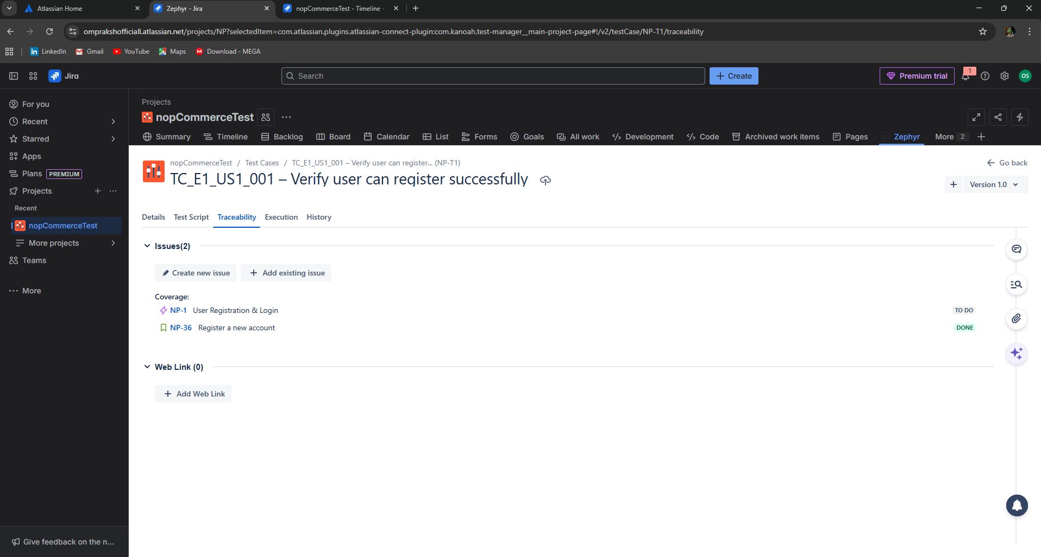
Jira backlog screenshot and description one line to show Agile work in sprint

Slide 9
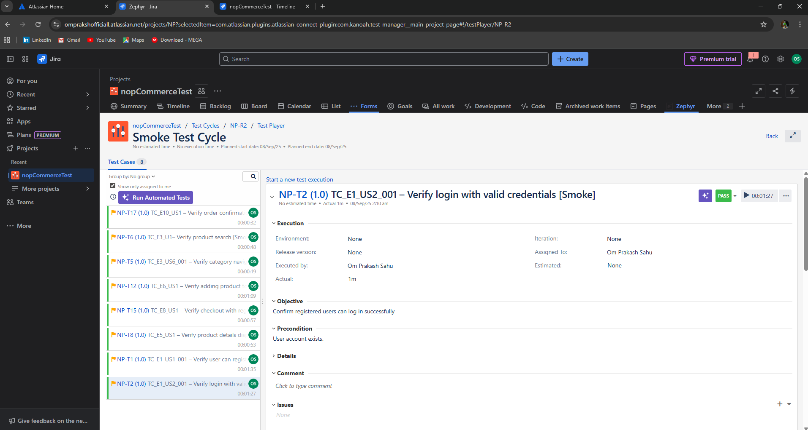
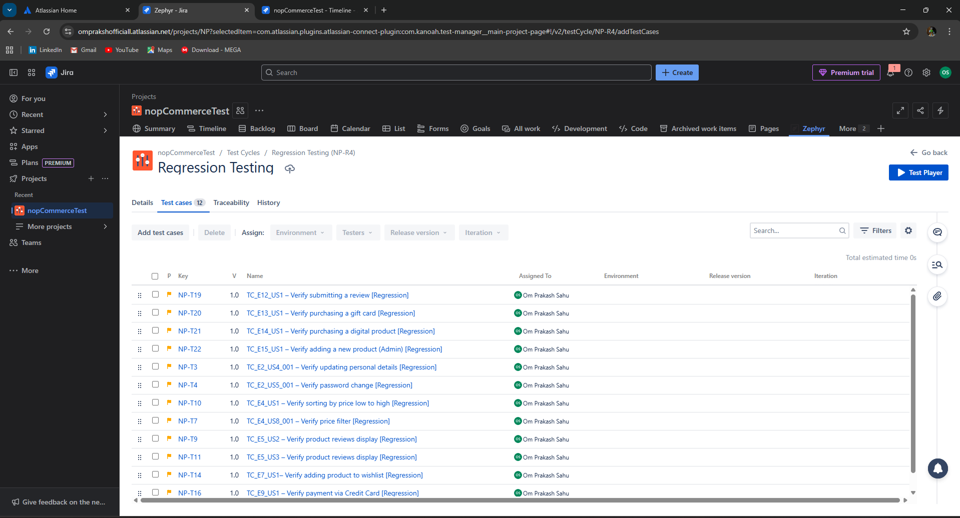
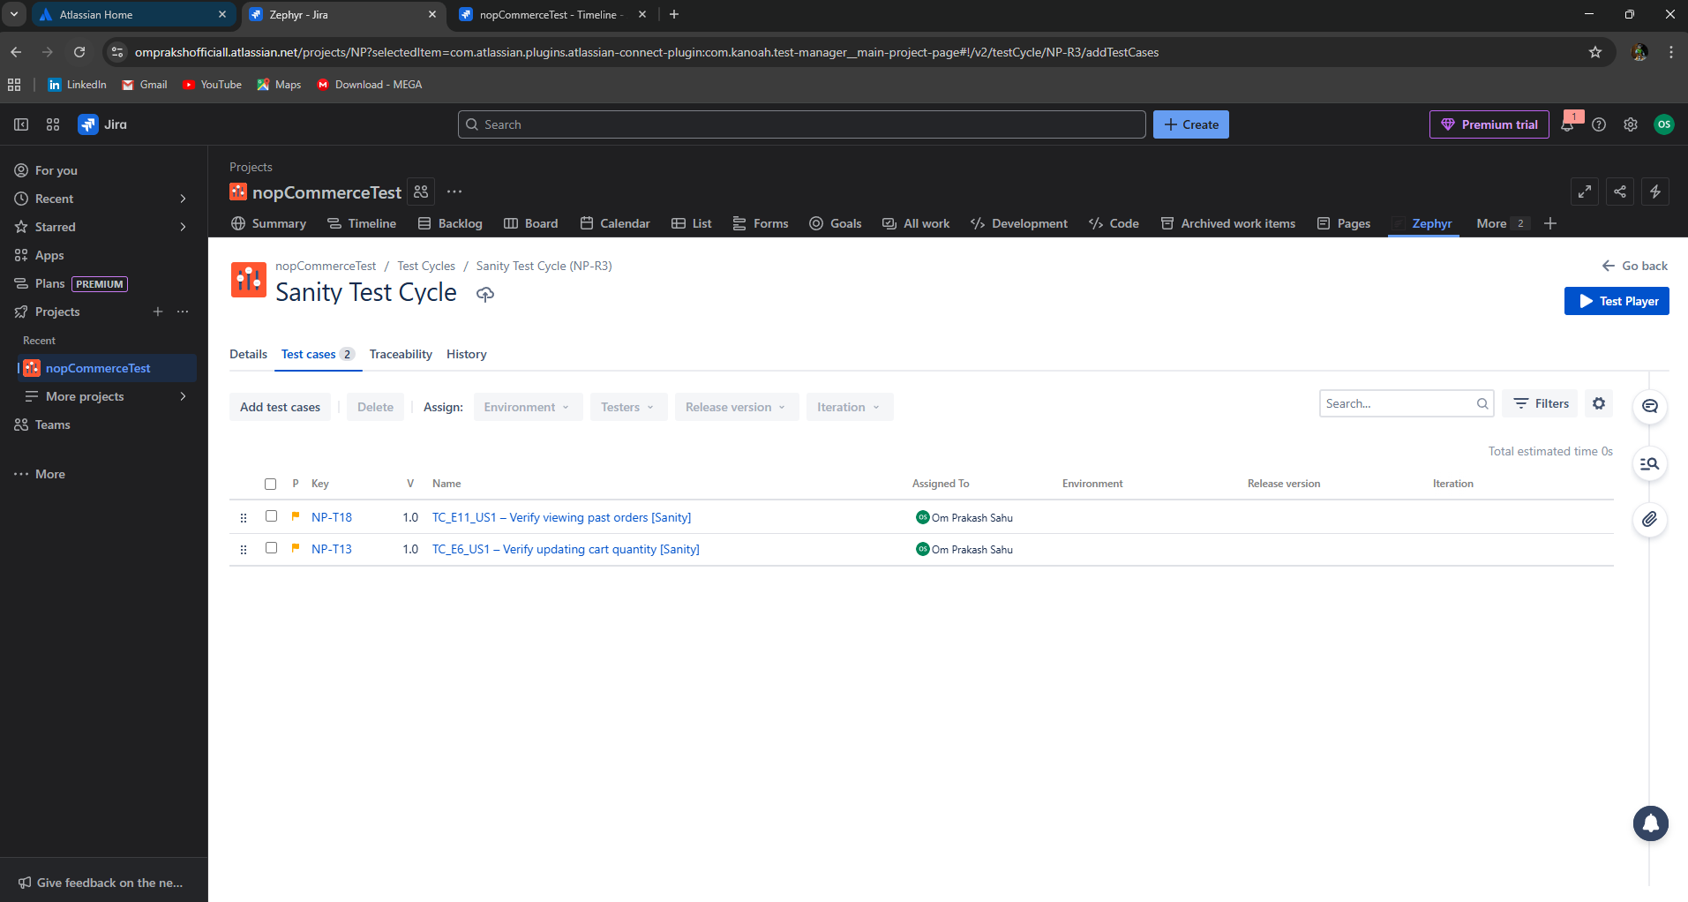
Zephyr Board Smoke , Sanity, Regression Test case

Slide 10
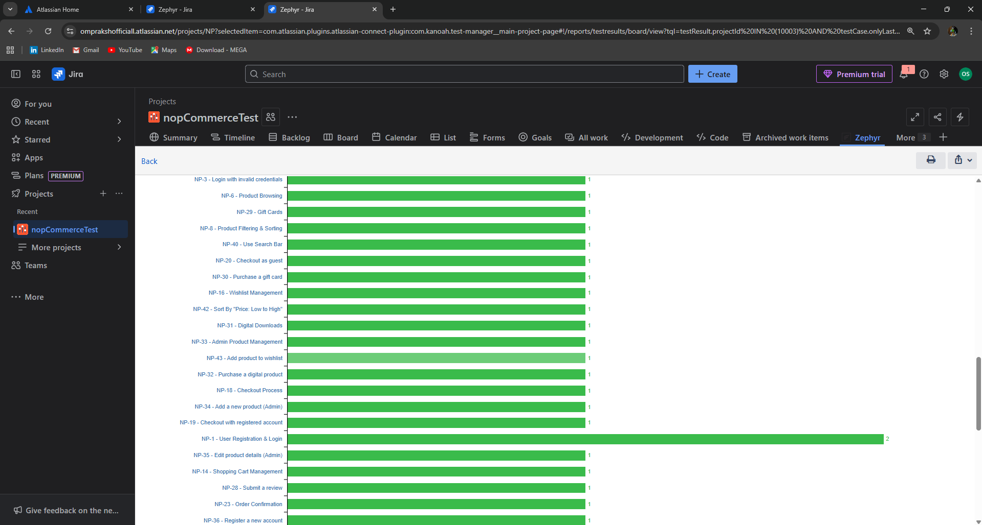
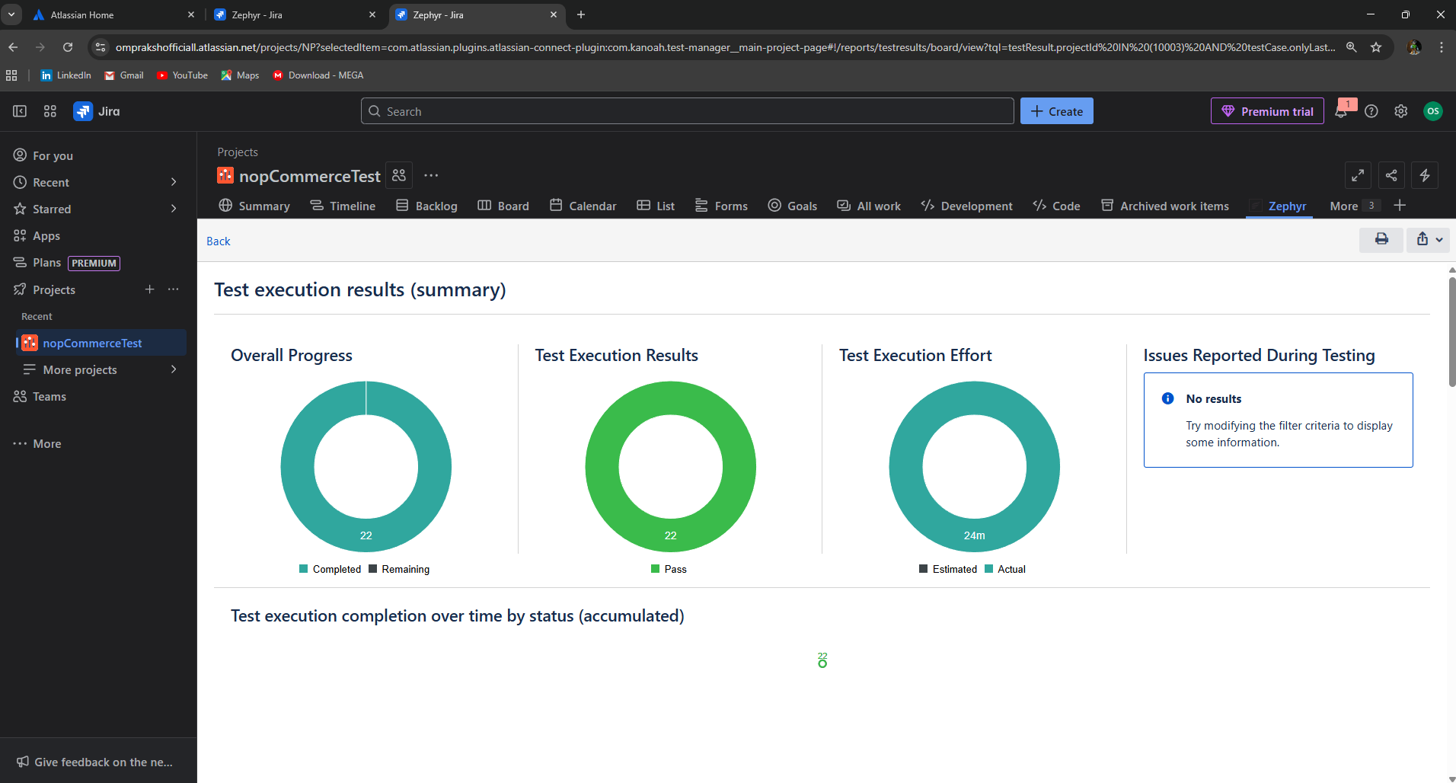
Test report from Zephyr screenshot

Slide 11
Thank You

